Slide 1
E-Membership
Doug Kokot
State E-Membership, Retention & Email Director

Slide 2
Free One Year Membership Through Dec 2021
Code: MCGIVNEY2020

Slide 3
How are we doing?
Brought in nearly 1000 E-Members
Michigan was number 2 in E-member conversions (49%) for Division 1 Jurisdictions
Number 1 was at 50%
Nearly 2/3^{rds} of the States new membership were
E-members

Slide 4
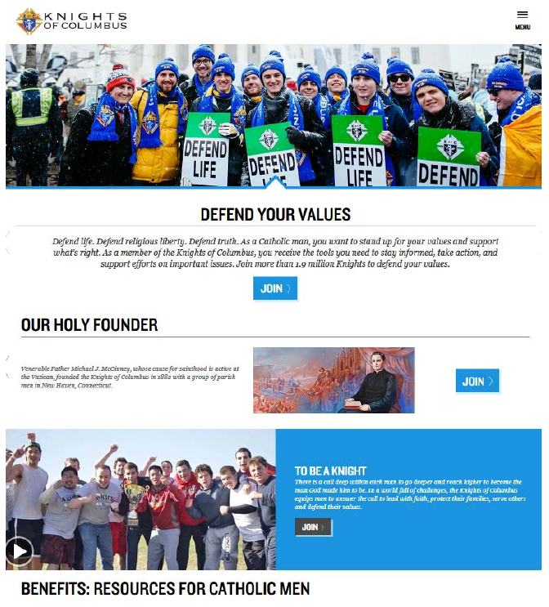
How to Join
WWW.kofc.org/Joinus

Slide 5
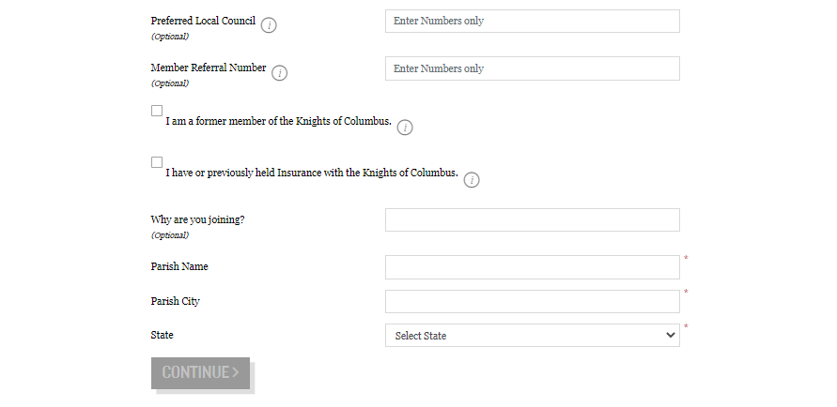
An email will be sent to the State Membership Team, Grand Knights & Financial Secretaries, when “Preferred Council” is selected by member.
Proposer Credit

Slide 6
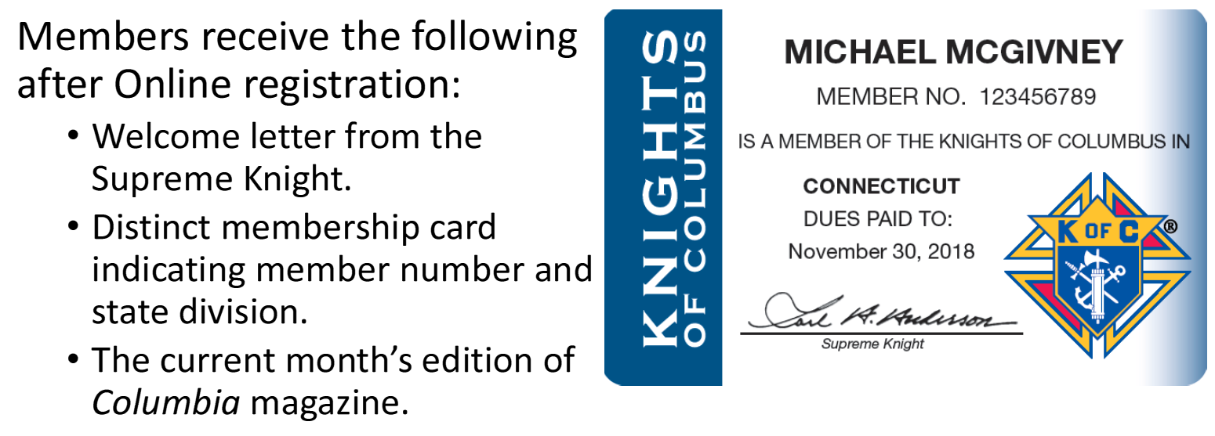
Online Member Welcome Packet

Slide 7
How the Process Works
If Online Members selects a local council, he will appear in under the “Prospect” tab in Officers Online immediately
If a council is not selected, he will be assigned to the nearest council, based on parish and personal address

Slide 8
Transferring E-members
After prospects are assigned, they can be viewed in the council’s prospect tab, by the Grand Knights and Financial Secretaries

Slide 9
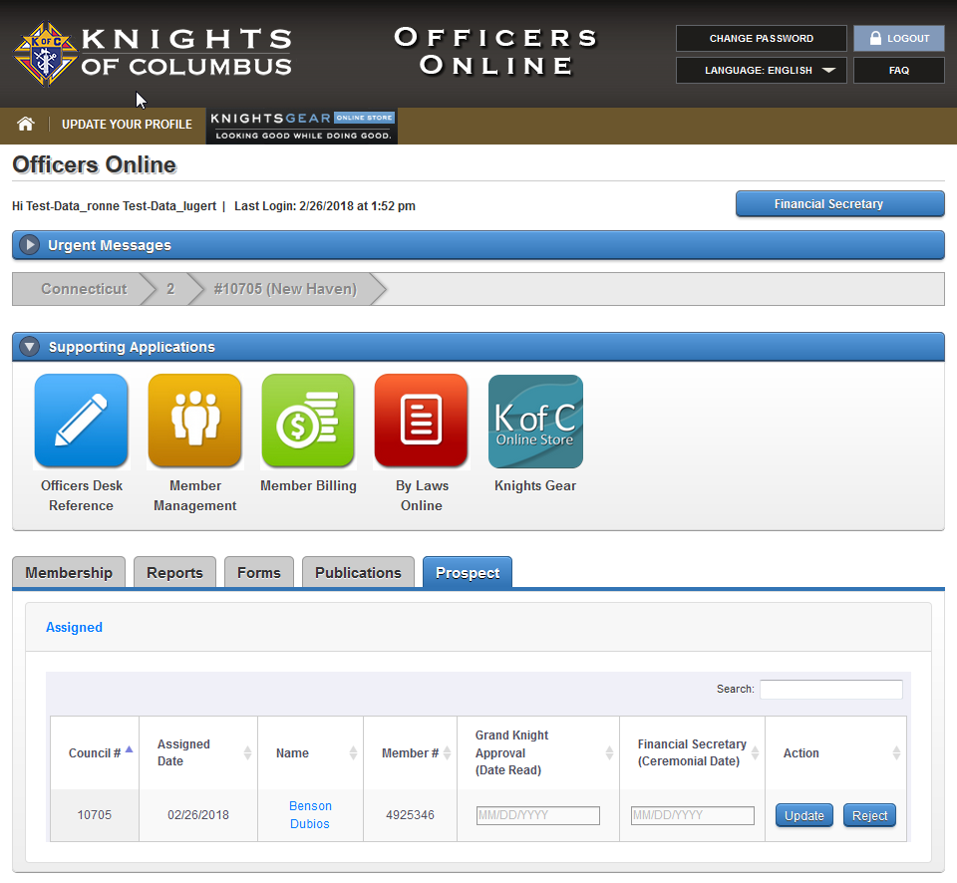
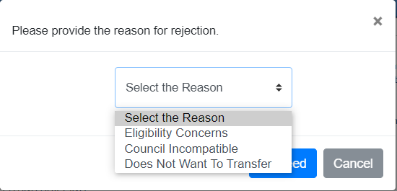
Transferring E-members

Slide 10
Transferring E-members
Once the member goes through the admissions process and has taken his admission degree, he can be transferred
Two Methods:
    Membership Online
    Form 100
If the member does not show up in the Assigned tab, the transfer can be completed using a Form 100

Slide 11
E-member Action Plan
Invite to get involved by helping out
Invite to a meeting
Create a friend
Then… Invite to join

Slide 12
Transferring E-members
There is NO NEED to submit a form 100 when using the online membership method
Councils will receive +1 when an online member transfers into a local council
If the member is an insurance client, you will receive a +1 for that as well
Notes:
Please note here that councils can reject a member. This can be done in cases of error in assignment or eligibility concerns. Please remember that issues of Catholicity should be made by the councils chaplain.

Slide 13
E-membership & agents
General Agents will be notified about all new members who join online and are assigned to their agency
Agents will contact and encourage online members to consider joining a local council

